Slide 1
The Agile Domain
Strategically Tackling Complex Software in a Modern World

Slide 2
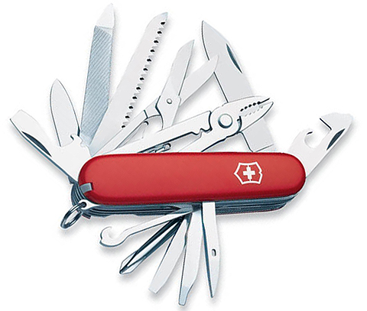
Software is Sometimes Created with the Intention of Doing This…

Slide 3
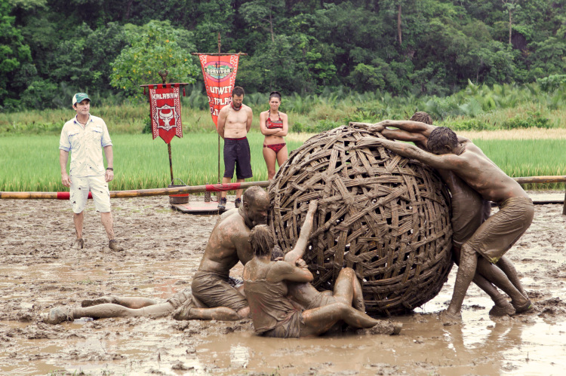
…But Can Become A Maintenance Nightmare Looking Like This
Notes:
A swiss army knife with features that make it do everything…
Security Module
Calendar Module
Person Module
Blog Module
Page Module
Forum Module
Can lead to what in Software terms is a big ball of mud

Slide 4
What is the Big Ball of Mud?
A Big Ball of Mud is a haphazardly structured, sprawling, sloppy, duct-tape-and-baling-wire, spaghetti-code jungle. These systems show unmistakable signs of unregulated growth, and repeated, expedient repair.
- Brian Foote and Joseph Yoder, Big Ball of Mud
Notes:
Start with definition, been through the big ball of mud

Slide 5
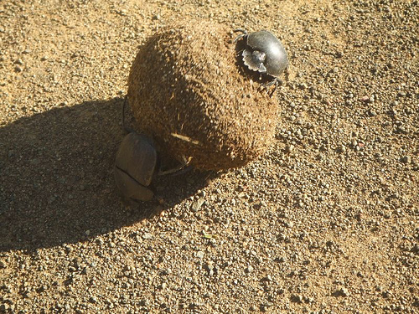
Living with a Big Ball of Mud
Notes:
Why is this a problem?
Most time spent repairing
Or making minor feature enhancements
Currently Geonetric is dealing with a big ball of mud with some of their software
Software is well architected, except a couple of modules, but weighed down by number of features
Active
Abandoned
Two choices, good software practices:
Long build times: 30+ minutes
Complex automated testing plans
Breakages to the build that can slow the team down for days
Or ignore good software practices
Leading to poor quality
Or very long regression times
These would take a month+ per release at its worse
At the time we were a Scrum team but couldn’t be very agile with our releases

Slide 6
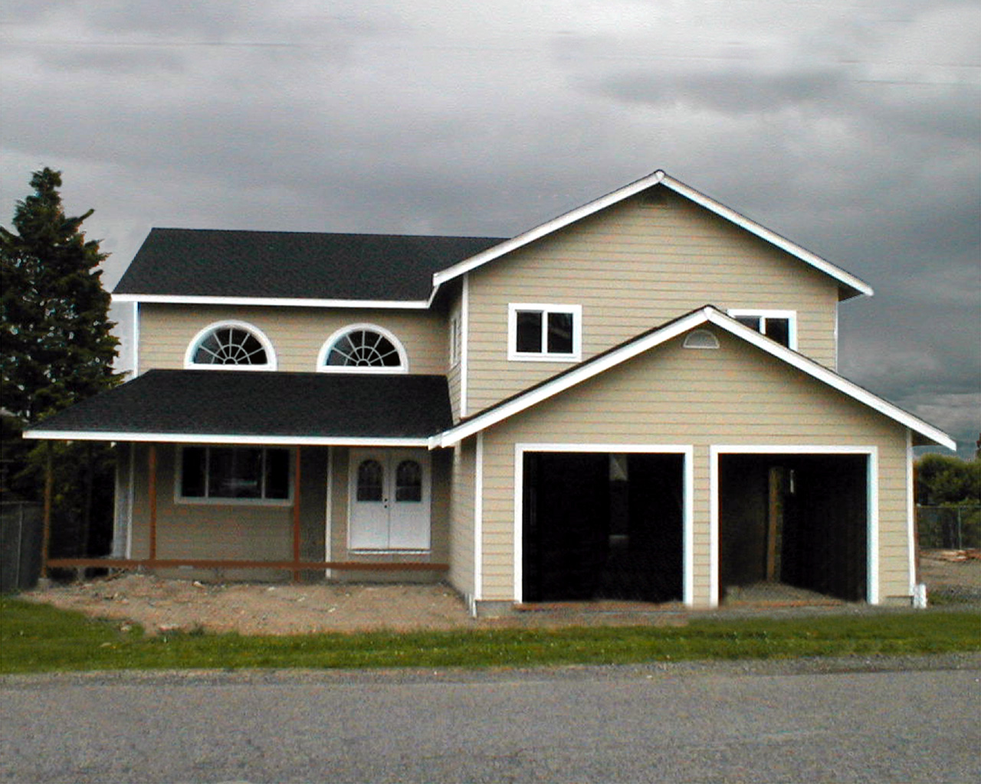
The CRAP Cycle: Create
Notes:
Visual Studio Article mention
Monolithic software will some times follow the CRAP cycle
At this stage software is
Well architected
Refactored and code kept pristine
Easy to understand the purpose
Small and managable
Due to focused intent of the software

Slide 7
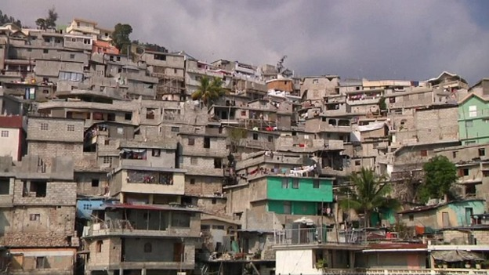
The CRAP Cycle: Repair
Notes:
Features get stacked on top of each other
Architecture starts to resemble shanti town
Builds start to slow down
releases take longer
harder to ensure quality
Hacks start to appear in the software as developers start to take shortcuts
Broken window theory
At this point the software starts to become a Big Ball of Mud

Slide 8
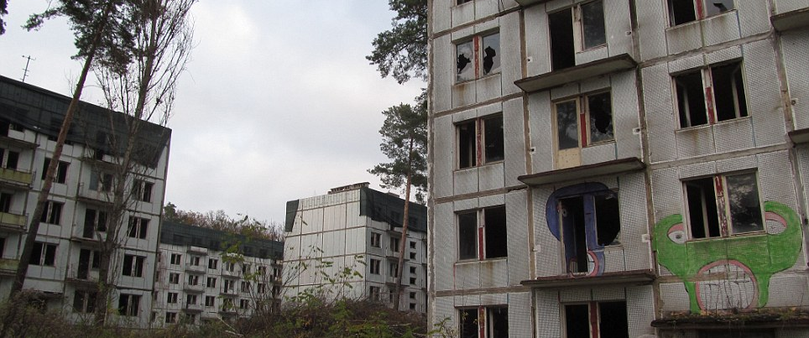
The CRAP Cycle: Abandon
Notes:
Hacks really start to build up
Harder to provide value
Talk of abandonment
Releases become less and less frequent or are restricted to minor updates and bug fixes
Due to the expensive nature

Slide 9
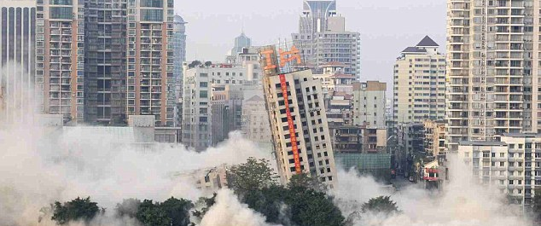
The CRAP Cycle: rePlace
Notes:
A concerted effort is made to replace the old monolithic app
At this point usually two teams form
The new team works on the new product, transitioning features to the new platform
The old team continues work on the product, keeping things working until new product is ready
Then the cycle starts over again, until the product reaches and gets replaced

Slide 10
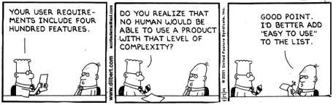
Bad Requirements Also Leads to Complexity
Notes:
SOLID principles may not be enough
Without good feedback features may be
Inaccurate
Or Wrong
Code can be sound architecturally
But provide little or no value to the customer
Leads to features that are abandoned or hurriedly patched
In the haste to patch code becomes messy and quality is sacrificed

Slide 11
Breaking the CRAP Cycle: A New Approach is Needed
One that satisfies the following needs:
Gets Quick and Useful Feedback
Uses Good Software Principles
Handles Complexity
Also be incorporated in agile methodologies
Notes:
So the big ball of mud can lead to software that slows the delivery of value or grinds it to a halt
A new approach is needed that satisfies these needs
Another requirement is it needs to work with agile methodologies

Slide 12
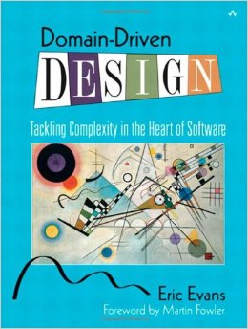
Introducing Domain Driven Design
Notes:
Written in 2003 by Eric Evans
Combines certain Strategic, Architectural, and Tactical patterns into a singular narrative for an organization to build software that can easily handle complexity
Focus on presentation will be on Strategic Design
Organizational patterns on how software should be put together from a feature perspective
Goal will be to provide a step by step guide on how Strategic Design can be used in conjuction with a big high value project
Examples drawn from Geonetric’s foray into DDD with some things rearranged or cleaned up from the lessons learned
A couple of things to keep in mind
DDD is not for all situations, it is only for software with some complexity or may get more complex in the future
A large amount of the material DDD covers is in the Tactical Patterns which are very technical and outside the scope of this presentation

Slide 13
Geonetric’s Approach to DDD First Figure Out What We Had
What is Geonetric’s overall mission?
To help clients market their brand online
This is Geonetric’s Domain
What does Geonetric do to accomplish that mission?
Form Builder, Calendar, Content Delivery, Structured Content, …
These are some of Geonetric’s Subdomains
What software has Geonetric created to help solve these problems?
These encompass Geonetric’s Bounded Contexts
Notes:
Engaged in an exercise that asked a series of questions
Domain: The overall business and the problem space it inhabits
Subdomain: Parts of the business that help with that goal and make up the Domain
Bounded Contexts: Software solutions for the problem spaces
This exercise helped teach the team about the business

Slide 14
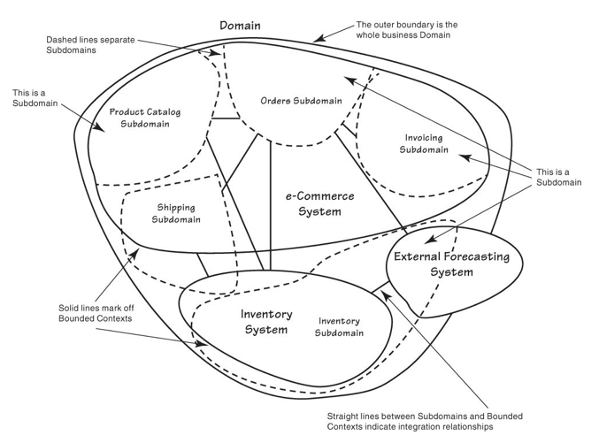
Subdomains And Bounded Contexts Visualized
Notes:
So by doing this exercise you can build a diagram that shows how everything relates together
Above is an example taken from one the DDD books
This visualization can be used to show other teams the current software topography of the organization
Note a couple of things here:
In this example subdomains cross bounded contexts
Bounded contexts contain many subdomains
This is normal for non-DDD architecture and should be expected should anyone else undertake this exercise

Slide 15
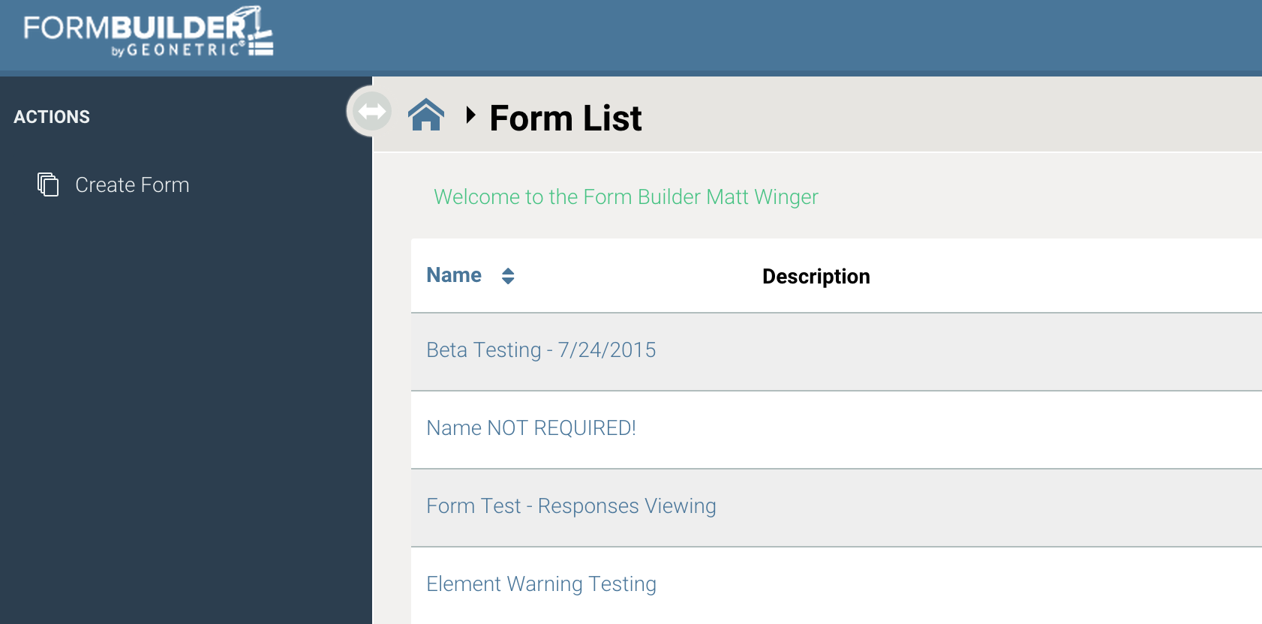
Focusing on the Next Big Problem
Notes:
Decision was made to use DDD for the next big project Geonetric undertook to test out the knowledge gained
The number one requested feature at the time was Form Builder
The Form Builder Context would allow organizations to capture HIPAA protected information
Example includes
Prereg form
Contact Us Form
Class Sign Up
Implementation would be on a multi tenant platform
Further projects would then be built into this architectural style
This allows the software to be kept self contained and at a managable size

Slide 16
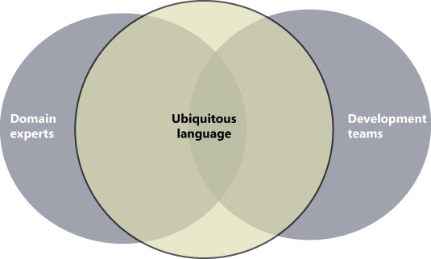
Creating An Organizational Language
Notes:
Built a glossary of terms
Became the ubiquitous language
Confined to the bounded context
Language of the team and domain experts
Bridges the gap between technical and non-technical members of the team, used in
Conversations about the software
Release Notes
User Guides
Talk more about Ubiquitous Language and it’s power

Slide 17
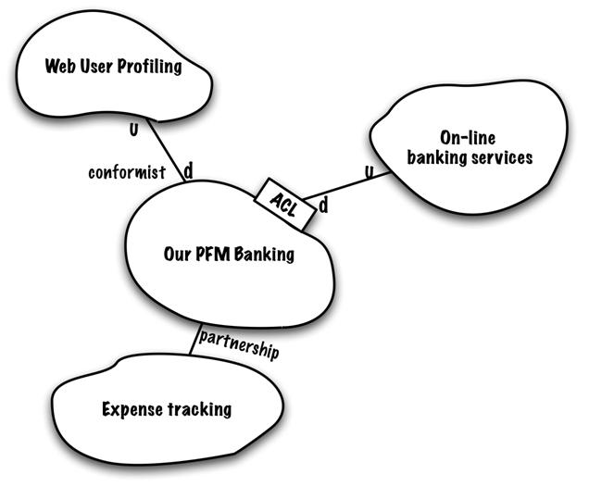
Mapping Out the Terrain
Notes:
Explain Context Map
Subdomain types of Core, Supporting, and Generic in regards to form builder

Slide 18
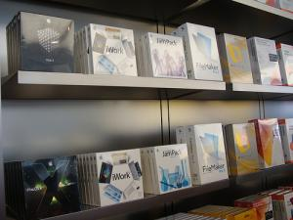
Getting Market Feedback Quickly
Notes:
Define Domain Expert
CAG
GAG
Outsourcing subdomains that are not the core domain

Slide 19

Keeping the Domain Pure
Notes:
Domain should only have Form Builder concepts, no security

Slide 20
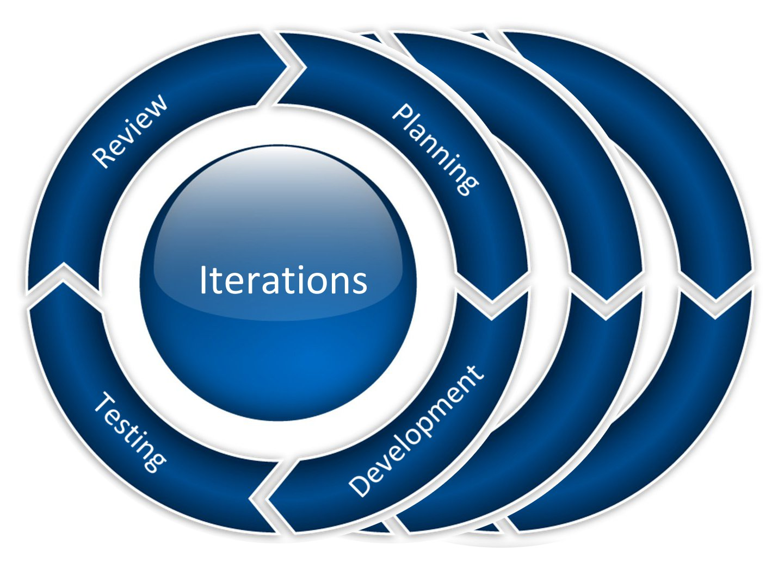
Iterate Quickly to Gain Business Knowledge
Notes:
Thin releases to get rapid feedback, history of form builder

Slide 21

Moving onto the Next Problem
Notes:
CDC next priority, process starts over

Slide 22
Summarizing
Strategic Design is the 10000 ft up portion of Domain Driven Design defining the relationship between bounded contexts and how to integrate them
The Domain is the problem space the organization operates in
The Domain consists of individual problems that are represented by Subdomains
Subdomains consist of Core, Supporting, and Generic subdomains
Bounded Context represents the solution space in software form
Each bounded context should be named by the <Context Name> followed by Context: Form Builder Context

Slide 23
Summarizing Cont’d
The Ubiquitous Language is the language of the team (developers and domain experts) and should be contained within the context being worked on
DDD should not be used with simple tools or CRUD apps with little business logic as it is not worth the overhead cost
Try to outsource Supporting and Generic subdomains whenever possible, otherwise develop using DDD principles if the subdomain is moderately complex

Slide 24
Summarizing, Finally Done
Integrating Bounded Contexts together will usually involve an Anti-Corruption layer on one side to keep the domain pure
Finally this is only a third of the material, Tactical Design gives patterns on how to architect the code itself minimizing complexity and allowing for a pure domain model
This is just an introduction, there is much more that I didn’t go through!

Slide 25
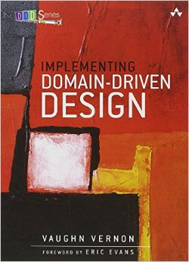
Further Reading
Notes:
2013 book by Vaughn Vernon, also known as the red book
Dense book that gets right to the point with implementation details
This is the book that did the best job in my opinion on explaining DDD

Slide 26
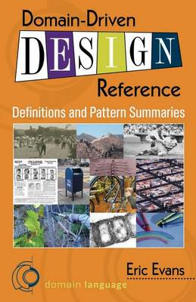
Further Reading Cont’d
Notes:
New pocket guide that just came out this year. Gives a good summary of all of the terms and ideas without a lot of details. There are a lot more books out there and other resources, these are just the familiar ones to me.

Slide 27
Finally…
My GitHub account where this presentation can be accessed:
rattrapdev-public
Also has test code where I will sometimes test out some of these DDD ideas.
I can also be contacted at my Geonetric email: matt.winger@geonetric.com
Or my gmail at: mateo6379@gmail.com

Slide 28
Any questions? Open discussion time!

